Slide 1
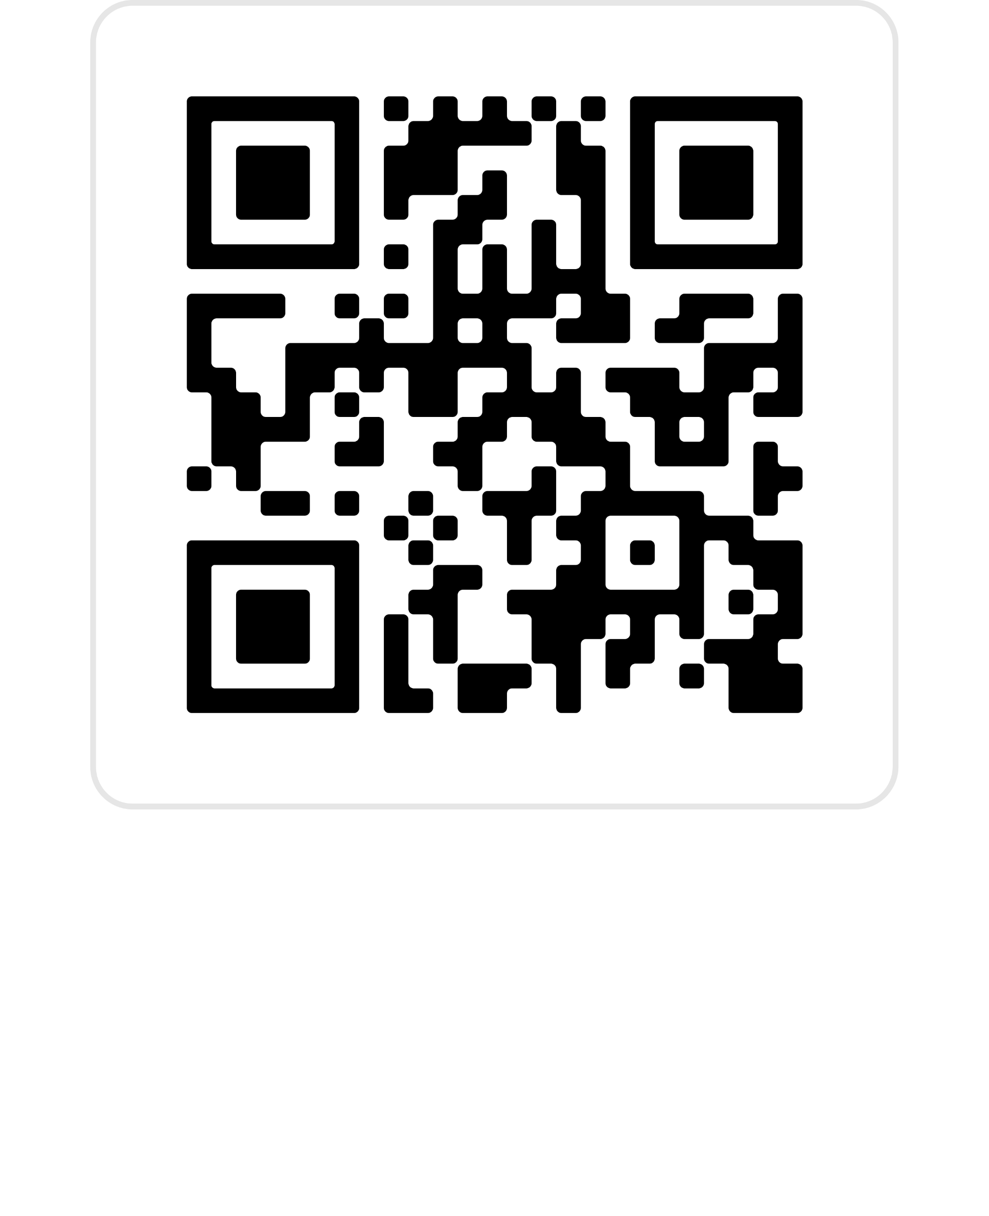
IDF World Diabetes Congress Bangkok, Thailand, 7 – 10 April 2025
Why attend
Key dates
10 programme streams
130 hours of scientific sessions
250 international speakers
1 Apr 2024 Registration opens
15 Jul – 15 Sep 2024 Abstract submissions
29 November 2024 Early rate deadline

