Slide 1



IDF World Diabetes
Congress 2025

Slide 2


4-day congress
10 programme streams
8 parallel sessions
130 hours of scientific sessions
250 leading international speakers
1000 e-posters
8000m² exhibition
Shape the future of diabetes
www.idf2025.org

Slide 3

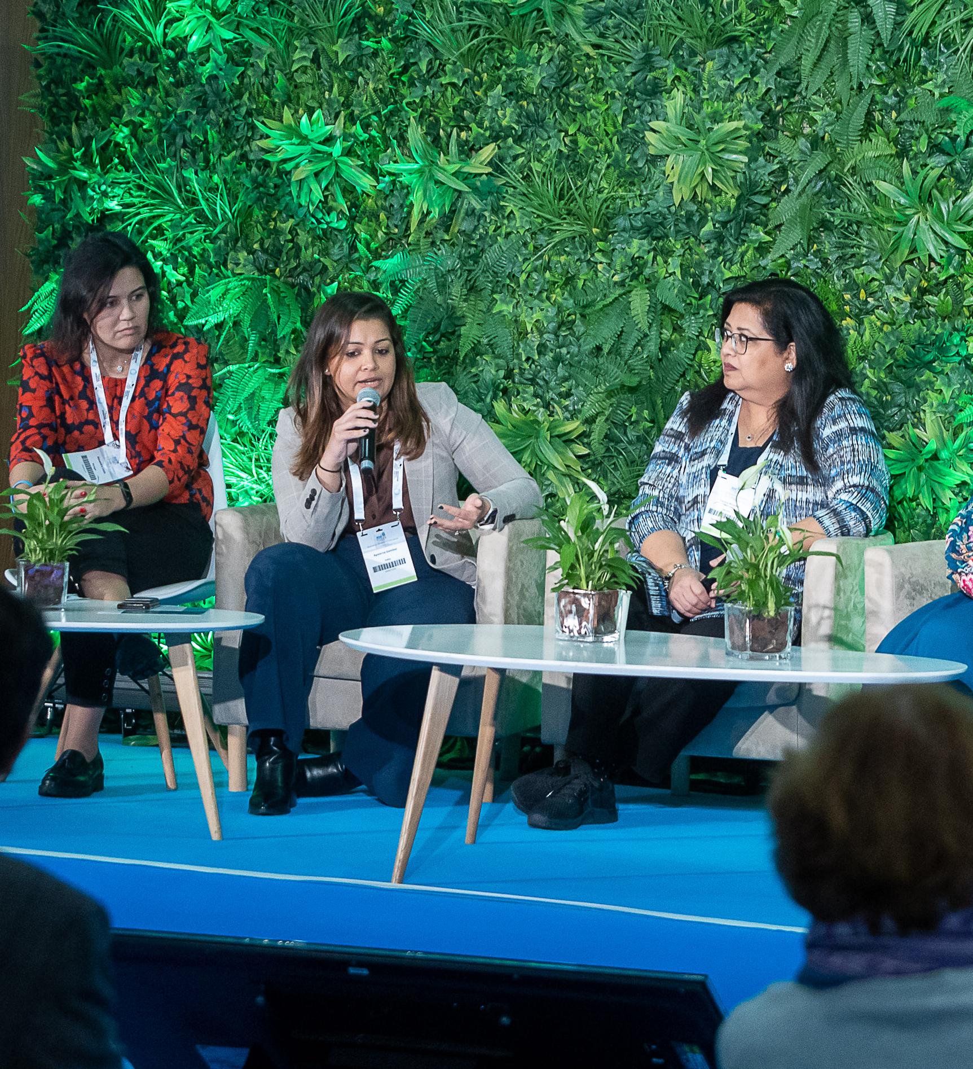
Basic and Translational Science
Classification and Differential
Management of Diabetes
Technology and Artificial Intelligence
Diabetes Complications
Type 1 Diabetes
Public Health and Policy
Education and Integrated Care
Epidemiology and Prevention of Diabetes
Women and Diabetes
Living with Diabetes
10 programme
streams
www.idf2025.org

Slide 4
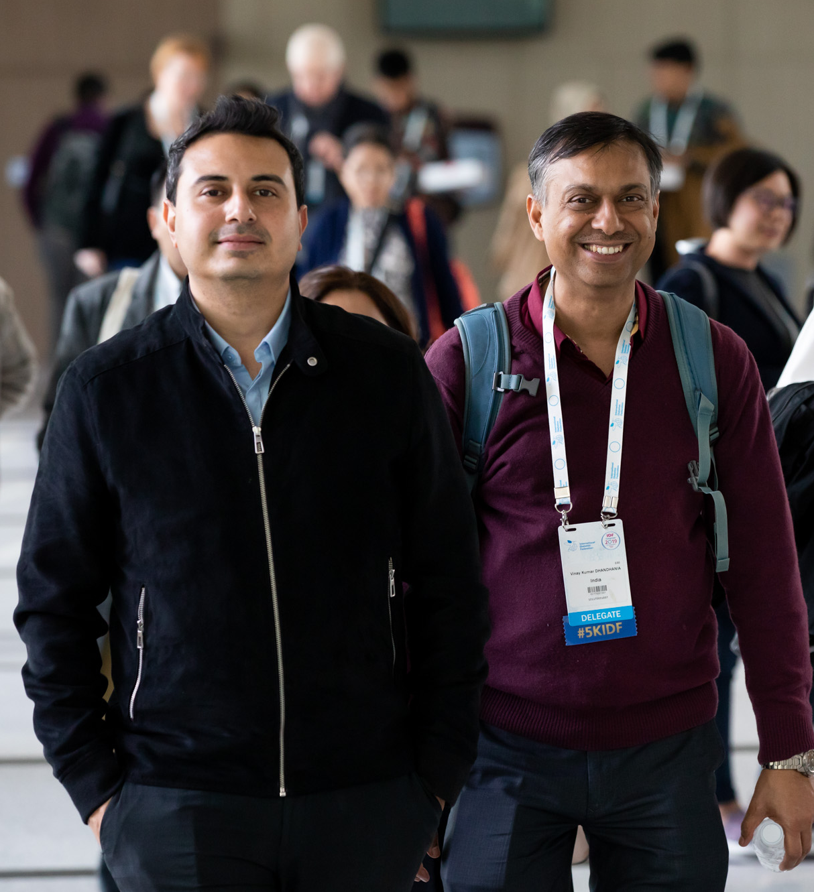
Individual and group rates
Discounted rates for HCPs in LICs and LMICs, students and IDF individual members
Access to all sessions live and VOD for 30 days
Access to e-poster gallery and international exhibition
An expected 25 CME credits for onsite attendance
Early rate available until 29 November 2024
Register at
attractive rates
www.idf2025.org

Slide 5


Learn.Discover.Connect
idf2025.org
congress@idf.org
#IDF2025

